Slide 1

Performance Metrics and Cross Validation
Michigan Hackers Machine Learning Team

Slide 2

Today’s Agenda
Announcements
Review Support Vector Machines
Performance Metrics
Cross Validation
Brainstorm Ideas for Next Semester
Work and Ask Questions

Slide 3
Announcements
The LSA Course Guide for Winter 2021 is out
Browse through the courses for next semester and see what you like
Friday Night AI: Teaching Robots through Natural Interactions
Date&Time: November 22nd, 7:00 – 8:30 pm
Learn about how reinforcement learning is used to create intelligent systems in the field of robotics.
This is our last meeting for the semester!
Please give us feedback on what you want to learn and accomplish for next semester.

Slide 4
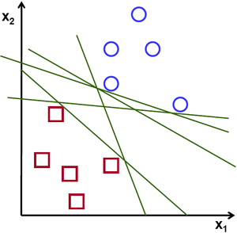
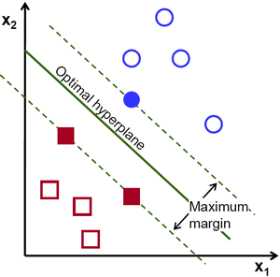
One Slide Review of Support Vector Machines
The objective of the support vector machine algorithm is to find a hyperplane in an N-dimensional space (N — the number of features) that distinctly classifies the data points.
Hard margin classification strictly imposes that all instances must be lie on one side of the decision boundary. There are two main issues with hard margin classification. First, it only works if the data is linearly separable. Second, it is sensitive to outliers.
To avoid these issues, we use a more flexible model. The objective is to find a good balance between keeping the margin as large as possible and limiting the margin violations (i.e., instances that end up in the middle of the street or even on the wrong side). This is called soft margin classification.
Simple Classification Algorithms
Support Vector Machine Algorithm
To separate the two classes of data points, there are many possible hyperplanes that could be chosen. Our objective is to find a plane that has the maximum margin, i.e the maximum distance between data points of both classes. Maximizing the margin distance provides some reinforcement so that future data points can be classified with more confidence.

Slide 5
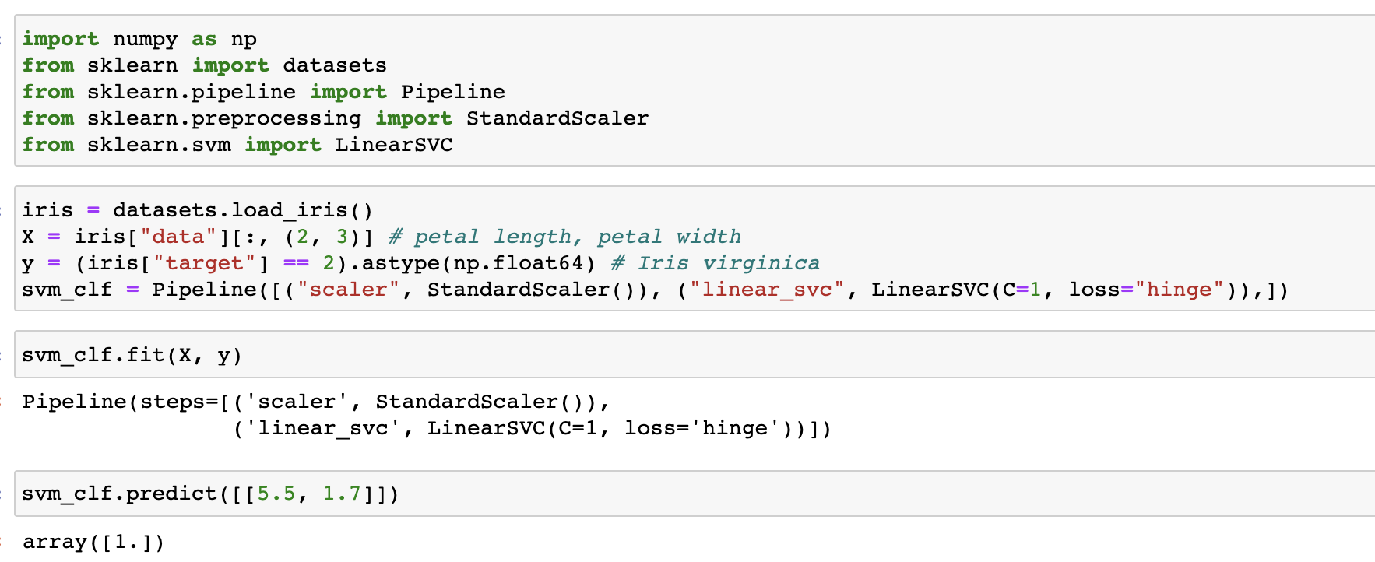
Implementation of Linear SVM

Slide 6
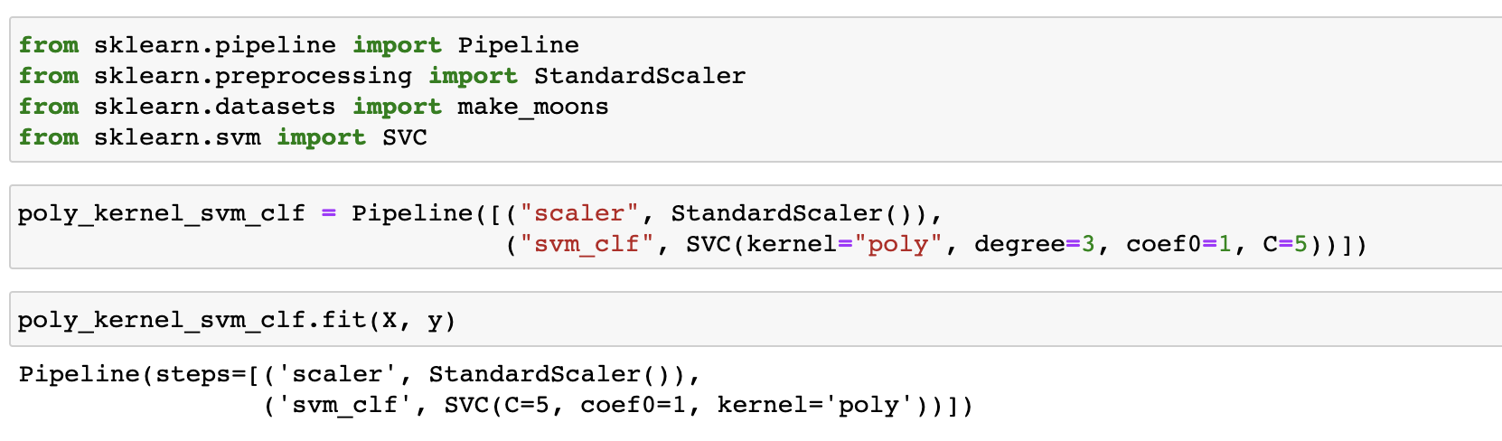
Implementation of Non-Linear SVM

Slide 7
Performance Metrics

Slide 8
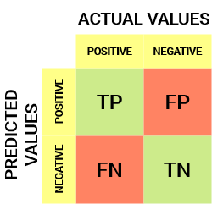
Confusion Matrix
Confusion Matrix gives us a matrix as output and describes the complete performance of the model.
There are 4 important terms :
True Positives : The cases in which we predicted YES and the actual output was also YES.
True Negatives : The cases in which we predicted NO and the actual output was NO.
False Positives : The cases in which we predicted YES and the actual output was NO.
False Negatives : The cases in which we predicted NO and the actual output was YES.

Slide 9

Accuracy
Accuracy is the ratio of number of correct predictions to the total number of input samples.
It works well only if there are equal number of samples belonging to each class.
The real problem arises, when the cost of misclassification of the minor class samples are very high. If we deal with a rare but fatal disease, the cost of failing to diagnose the disease of a sick person is much higher than the cost of sending a healthy person to more tests.

Slide 10
Sensitivity / True Positive Score
Description:
Formula (screenshot):
Pros and cons:

Slide 11
Specificity / True Negative Rate
Description:
Formula (screenshot):
Pros and cons:

Slide 12
Precision
Description:
Formula (screenshot):
Pros and cons:

Slide 13
Recall
Description:
Formula (screenshot):
Pros and cons:

Slide 14
F1-Score
Description:
Formula (screenshot):
Pros and cons:

Slide 15
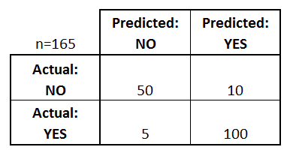
Example
Confusion Matrix for a Binary Classification problem. What performance metrics would work best to train your model?

Slide 16
Performance Metrics in Python

Slide 17
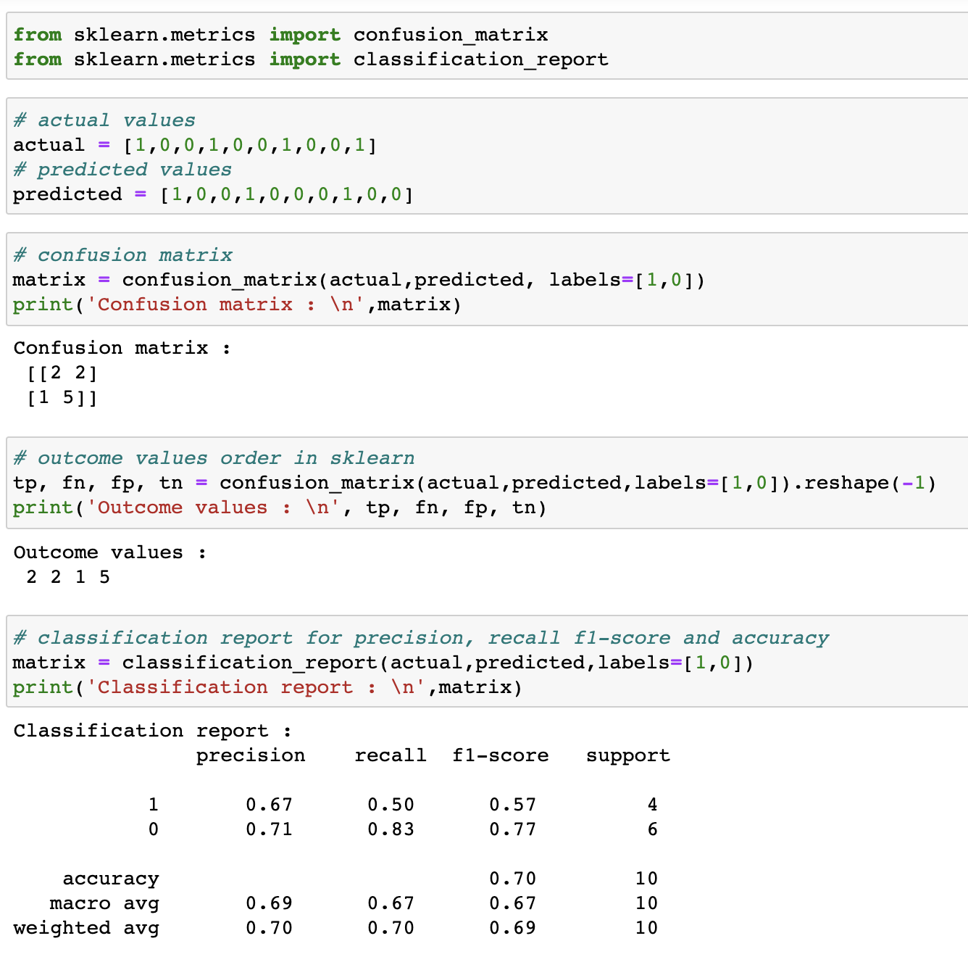
Import Libraries and Set Data

Slide 18
Getting Metrics

Slide 19
Cross Validation

Slide 20
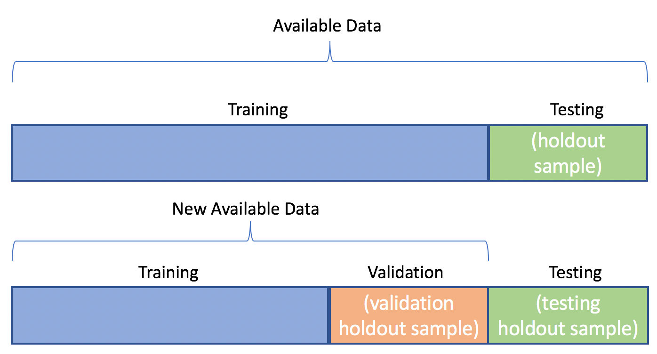
Cross Validation

Slide 21
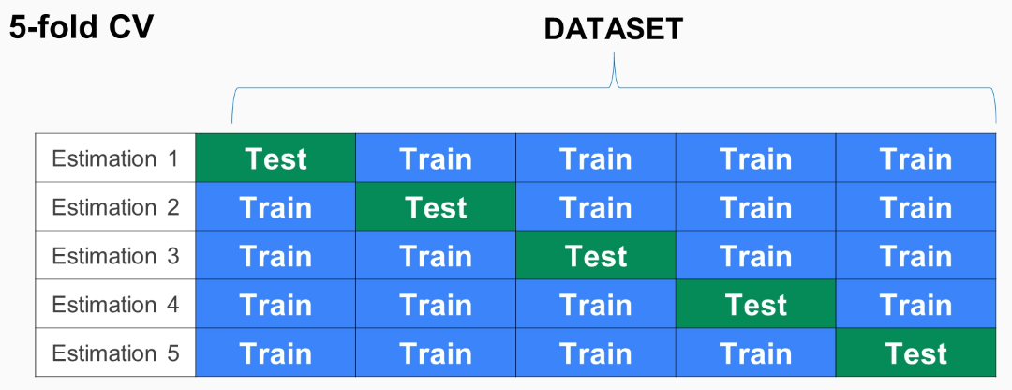
k-fold Cross Validation
Notes:
source: https://subscription.packtpub.com/book/big_data_and_business_intelligence/9781789617740/2/ch02lvl1sec14/k-fold-cross-validation

Slide 22
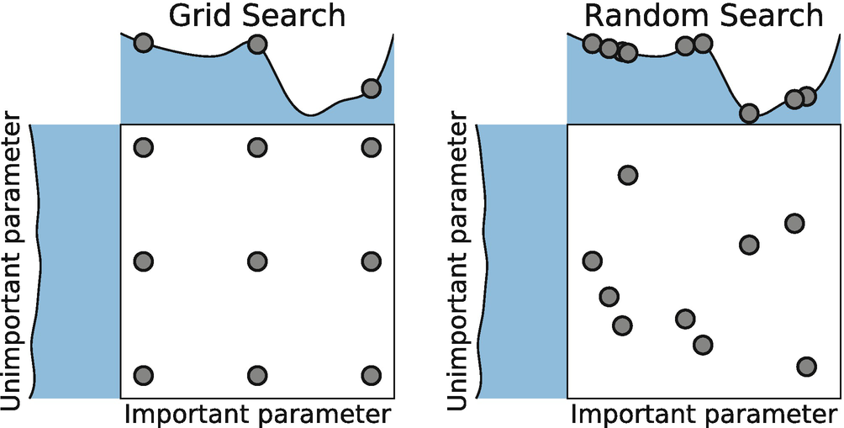
Hyperparameter Selection
Notes:
source: https://medium.com/@cjl2fv/an-intro-to-hyper-parameter-optimization-using-grid-search-and-random-search-d73b9834ca0a

Slide 23
Project Ideas and Club Improvements

Slide 24
Thank You!
Michigan Hackers Machine Learning Team
Contact Info:
Rajas Gupta | rajasg@umich.edu
Vijay Shamra | vsharm@umich.edu
Provide Feedback

